Slide 1

WORLD HAPPINESS ANALYSIS

Slide 2

What is happiness ???

Slide 3

Happiness
Happiness is that feeling that comes over you when you know life is good and you can't help but smile.

Slide 4
introduction
The World Happiness Report is a landmark survey of the state of global happiness.
The first report was published in 2012, the second in 2013, the third in 2015, and the fourth in the 2016 Update. The World Happiness 2017, which ranks 155 countries by their happiness levels, was released at the United Nations at an event celebrating International Day of Happiness on March 20th.

Slide 5
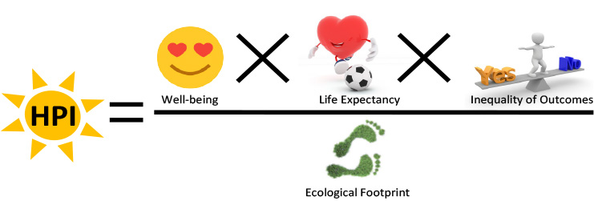
HAPPINESS INDEX
Happiness index is a development philosophy as well as an index which is used to measure the life satisfaction, which is the measure of collective happiness of a nation.

Slide 6
OBJECTIVE
The main purpose of the project is to measure the happiness index of the world and ranking of the countries based on happiness criteria by performing data analysis task from the data collected based on life evaluation questionnaire asked in a poll.
We are going to look at multiple factors that might influence happiness among people across the globe which we term as key parameters for happiness.

Slide 7

Parameters of happiness index
Housing
Work
Income
Community
Education
Environment
Health
Life
Satisfaction
Safety and Life work balance

Slide 8
SOURCES
The World Happiness dataset which ranks 155 countries by their happiness levels, was released by The United Nations and was collected by conducting life evaluation questions asked in a poll.
The factors considered for the survey :
Happiness score
Economy or GDP
Health
Freedom
Perception of Government Corruption
Family or Social Support
The data set considered, currently has 5 year’s worth of data from the year 2015 to 2019.

Slide 9
Processes PERFORMED ON DATA
Data Enriching : Data enriching involves adding value to the data already collected to enhance it for the analysis to be done to give the data more context.
Data Wrangling: Data wrangling involves unifying messy raw data into a form which is simpler to access and handle
Data Cleaning: the process of preparing data for analysis by removing or modifying data that is incorrect.
Data Validation: Data validation is checking if the data has undergone the cleansing it requires to be used.

Slide 10
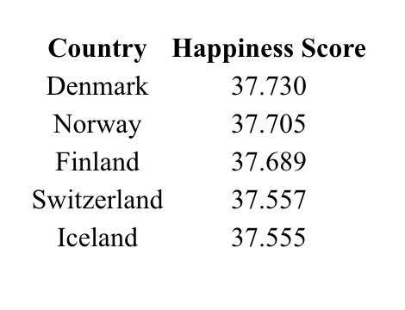
Business questions analyzed
To find the happiest countries all over the world based on the happiness score
Based on the master data set made on combining 5 years of worth of data from 2015-2019 we find the top 5 countries that are the happiest based on the happiness score.

Slide 11
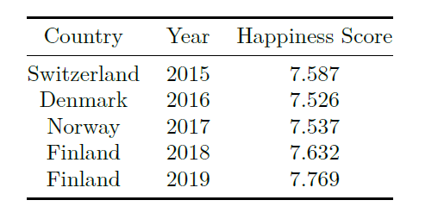
To find out the countries that take up the top spot on the happiness score over the years
As we can see from the table above we have obtained the list of all the countries that have held the top spot between the years 2015-2019.We can see that all of the countries in the list belong the European region.

Slide 12
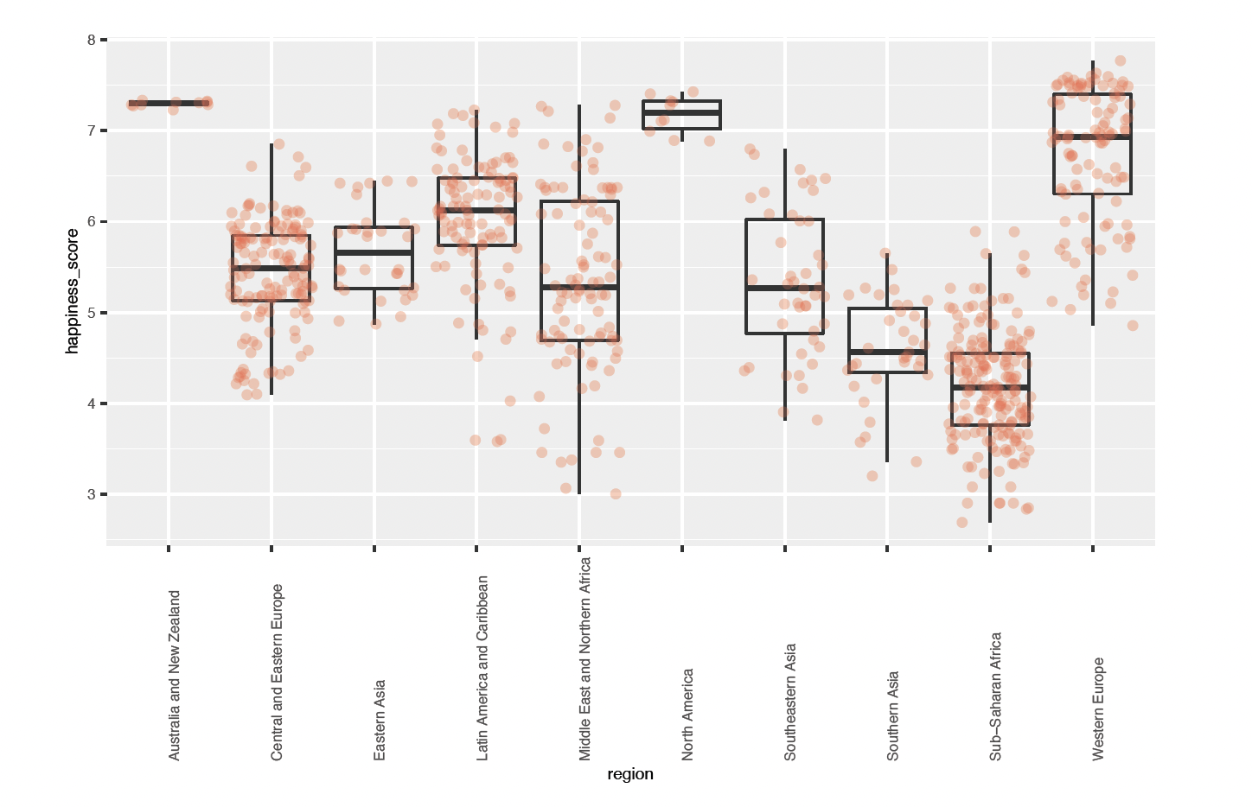
To compare the happiness scores across various regions
As we can see from the box plot Australia and New Zealand rank the highest in the average happiness index while the lowest is seen in the Sub Saharan African region.

Slide 13
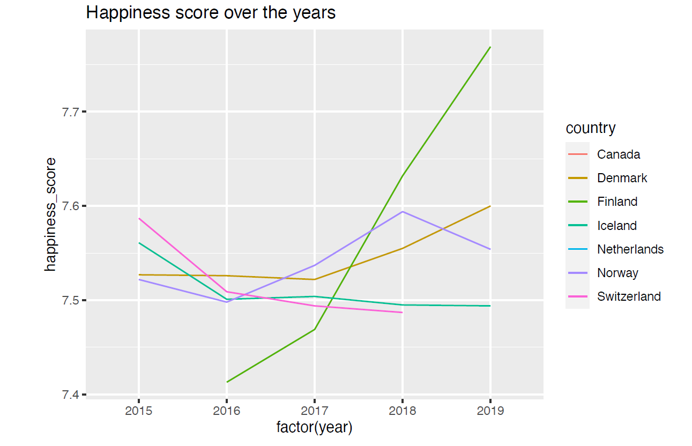
To find the country with a significant hike in happiness over the years
The plot shows us that there is a significant hike in the happiness score for Finland over the years, while there is dip in the score for Switzerland over the years.

Slide 14
Deep Dive into Finland
Finland has the highest spike of happiness score in the recent years
Finland also holds the first place in the happiness rank in 2018, 2019, 2020 and 2021
What are the factors influencing the happiness score of Finland?

Slide 15
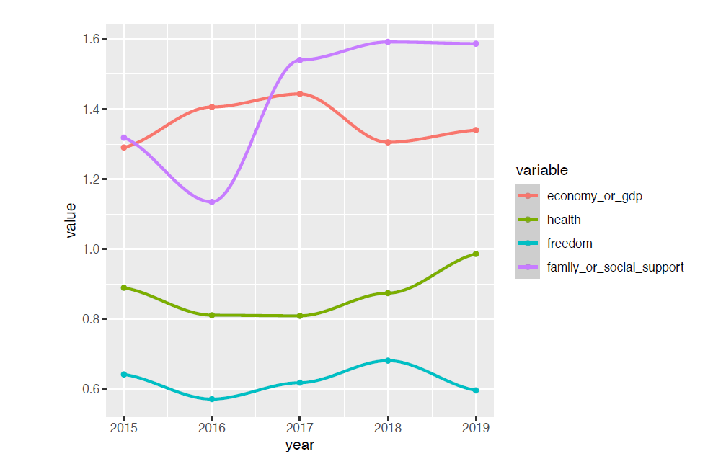
What were the factors causing the spike in Finland’s happiness score from 2016 to 2019?
The family or social support has seen a significant rise in Finland in the years starting from 2016 to 2019
The health factor also has an increase, but the increase isn’t as significant as the social support and family factor

Slide 16
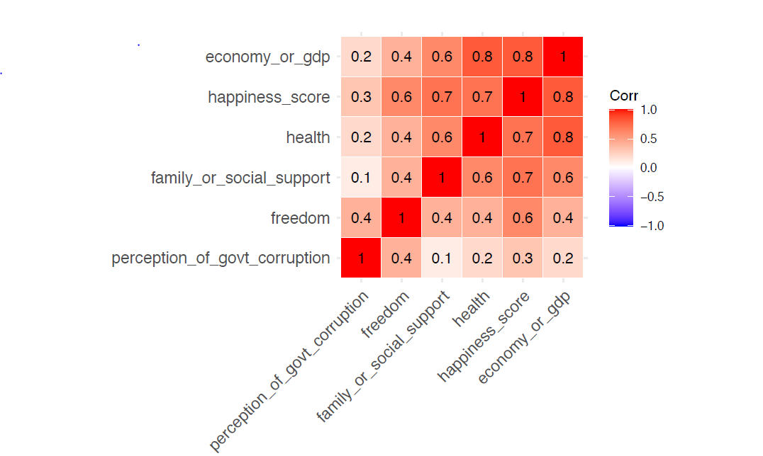
To find the factors that significantly affect the happiness factor
GDP is the most contributing
factor towards the happiness score with
a correlation coefficient of 0.8 followed by
health and social support/family with
a coefficient of 0.7.
The least contributing factor seems to be
perception of government corruption with a
Pearson’s correlation coefficient of 0.3.
Economy is also correlated with the health factor with a correlation of 0.7

Slide 17
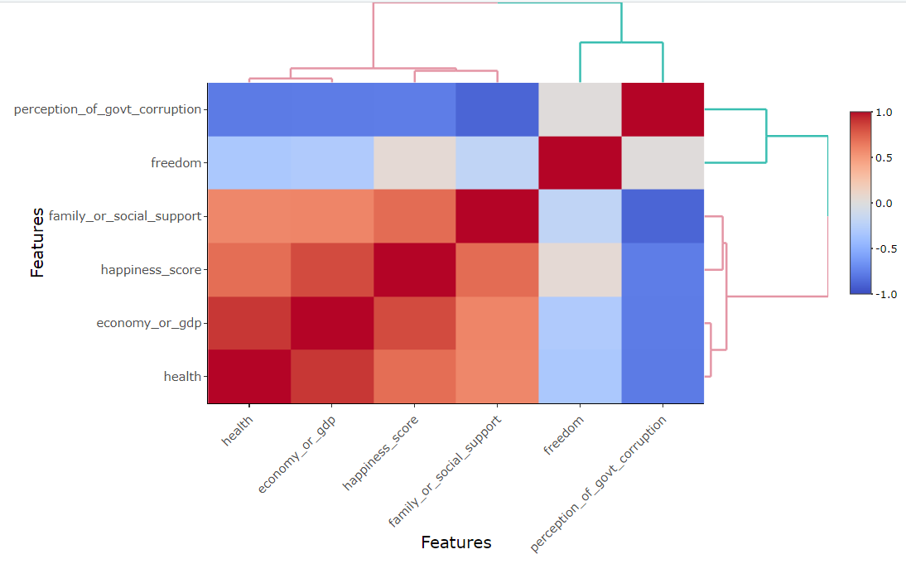
To visually represent the data based on color to show the intensity of the relation between the various factors
Happiness score is strongly related
to family support and GDP hence
it’s more towards the red tinge,
while the perception of government
corruption is not as strongly related
and hence it’s more towards the
blue tinge

Slide 18
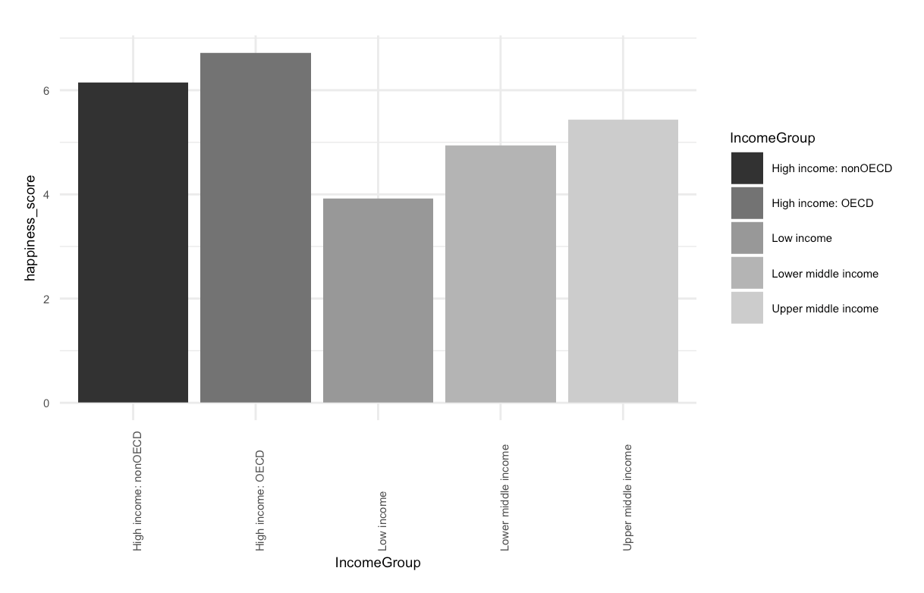
Are richer or developed countries happier than the rest?
Higher income countries seem to have a higher happiness score when compared to the countries with other income categories, which validated our hypothesis that the rich countries tend to be happier

Slide 19
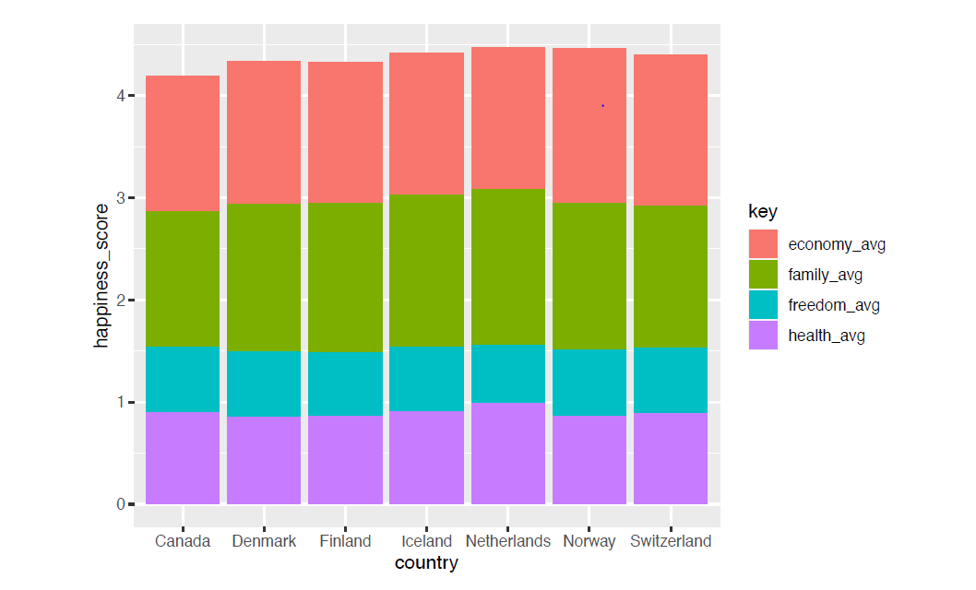
To compare the extent of influence each factor has on the top 5 countries
The family average occupies
a huge chunk in the stack along with
the economy
The economy average comes in next
while freedom comes in last for the
countries considered.

Slide 20
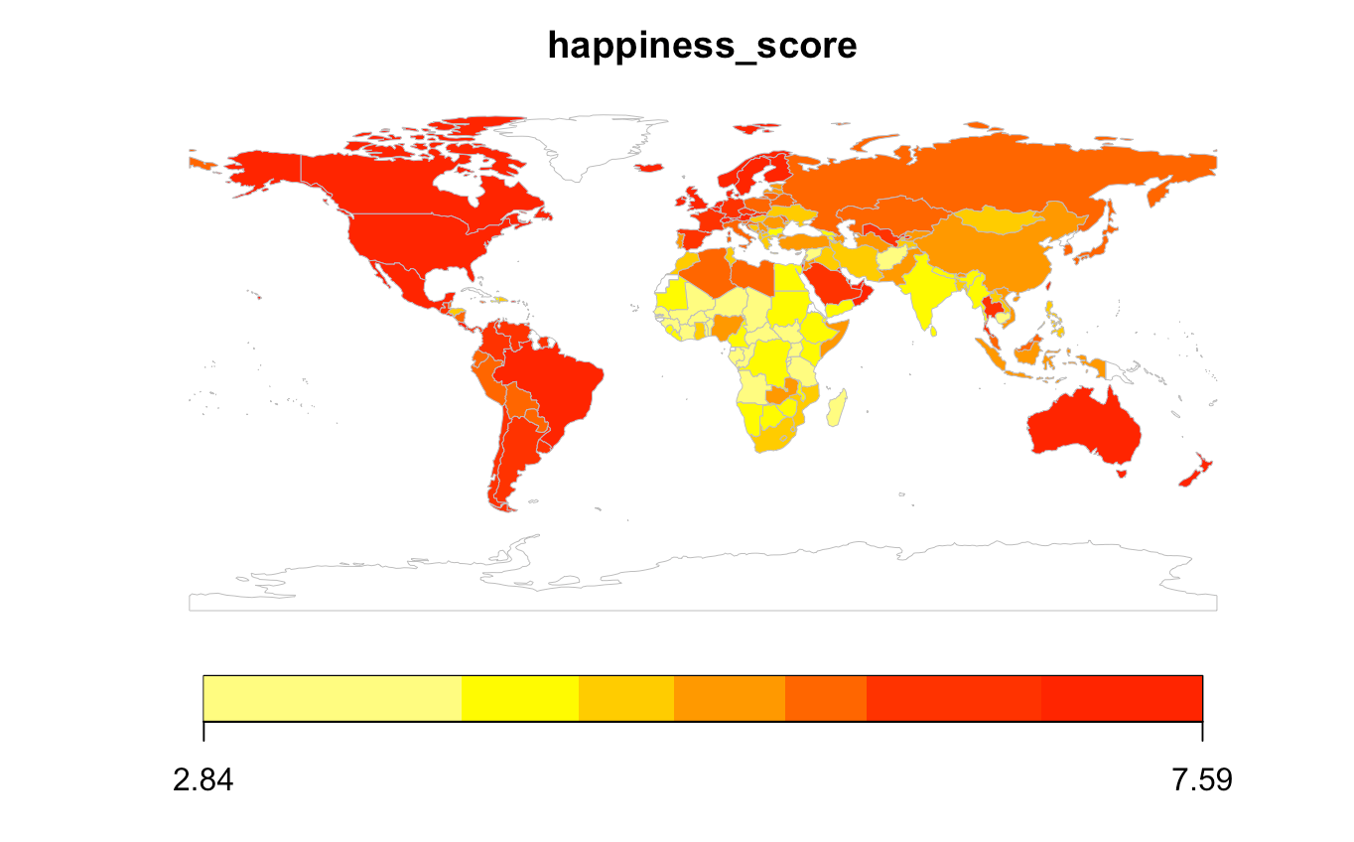
How is the happiness varying across geographies?
The left part of the world with North America and South America seems to be happier than the rest of the world
Countries around Africa and Asia seem to have the lowest happiness score

Slide 21
CONCLUSION
The Happiness data set helps us to get important insights into factors that seemingly affect the happiness of the world. With different factors like poverty, low health systems, strained relationships and lack of freedom in many nations of the world is causing widespread unhappiness
Our attempt to take a closer look into the world’s happiest and unhappiest countries and dividing the causes into basic factors to break down the possible causes, so that improvements in different fields may lead to happier nations and in turn a happier world
The rest of the world can learn a few things from Finland, which has been in the first rank for the past 4 years. Few factors which make Finland the happiest:
Chilled out way of life
Low crime levels
High standard of living
Superb education system
The Finns believe in the saying ‘Happiness does not come from searching for it, but by living.’”

